Slide 1
Nicla- Bakery
ABATONI Ariella

Slide 2
Welcome to the Bakery Website Project for Nicla!
I decided to work on the website of a bakery named Nicla which makes cakes, croissants, muffins, cupcakes, cookies, bread and many other pastries.
Developing a website for Nicla, a bakery known for its delicious baked goods.
The goal is to create a user-friendly, visually appealing website to showcase products and allow online orders.

Slide 3



SOFTWARES USED
Text editor: Visual Studio Code Programming languages used

Slide 4

CONT……
Browser used: Microsoft edge

Slide 5
Key Features
Home page with bakery information and contact details.
Product catalog with categories (cakes, bread, pastries).
Contact form for customer inquiries.

Slide 6
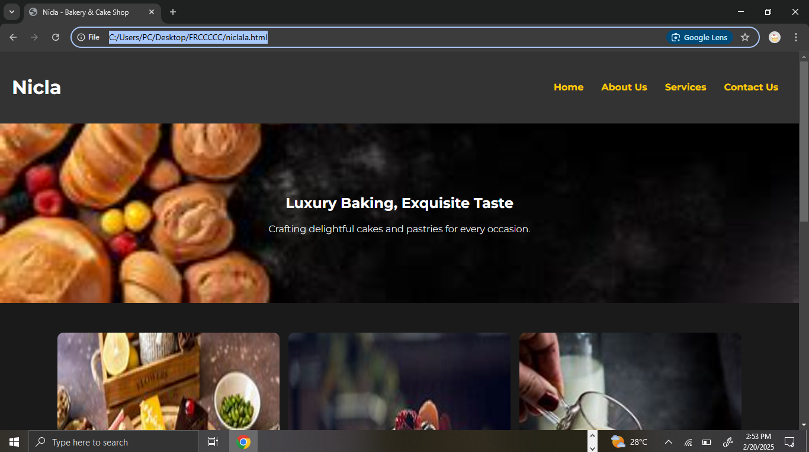
SCREEENSHOTS

Slide 7
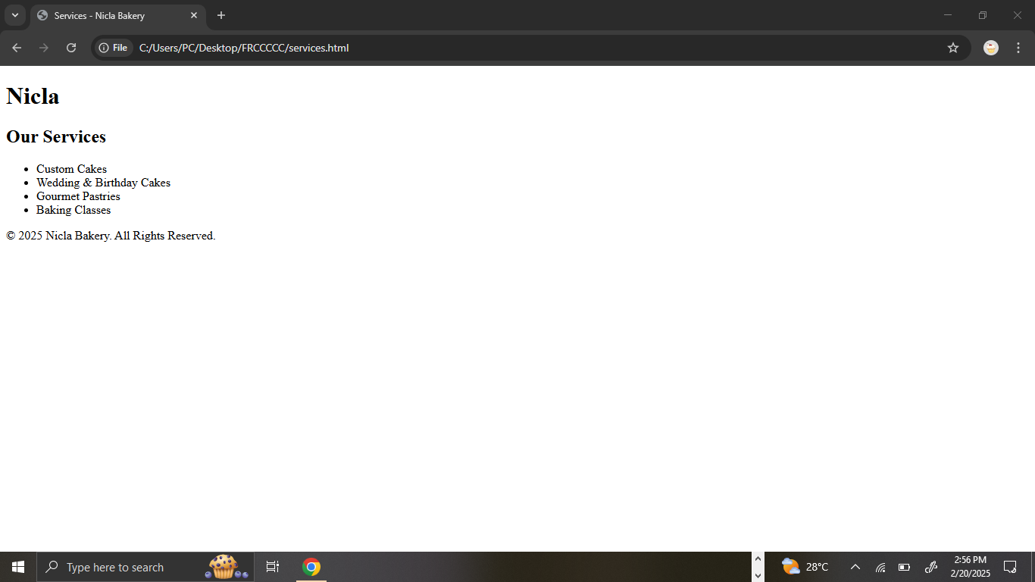
Services page

Slide 8
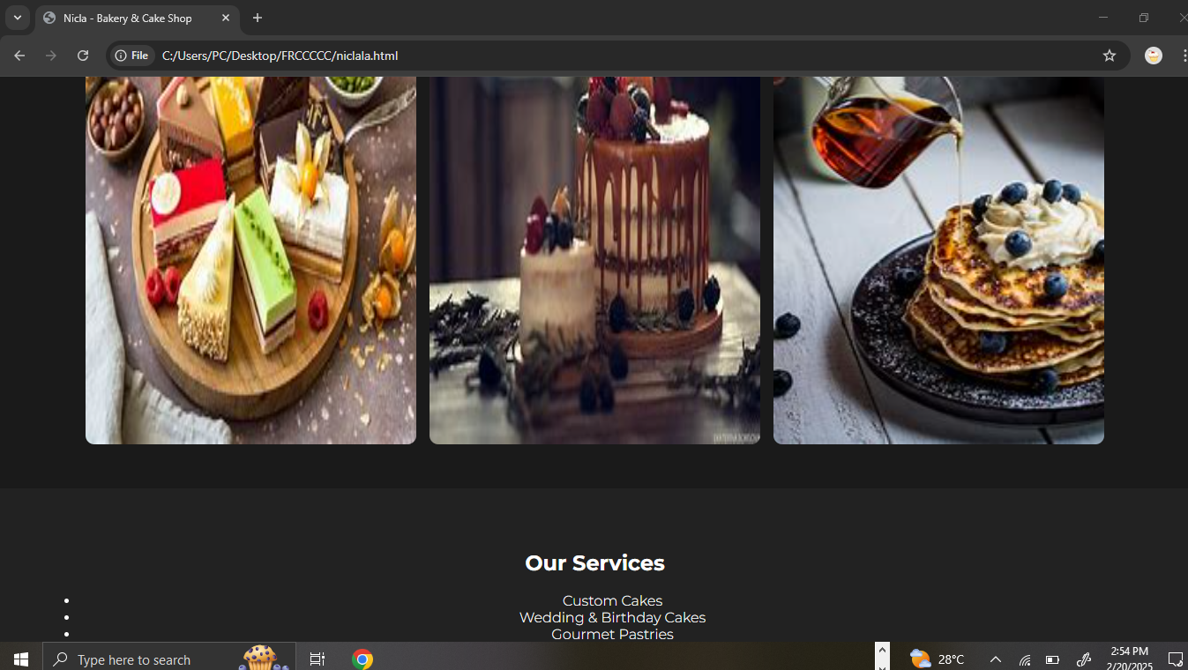
more

Slide 9
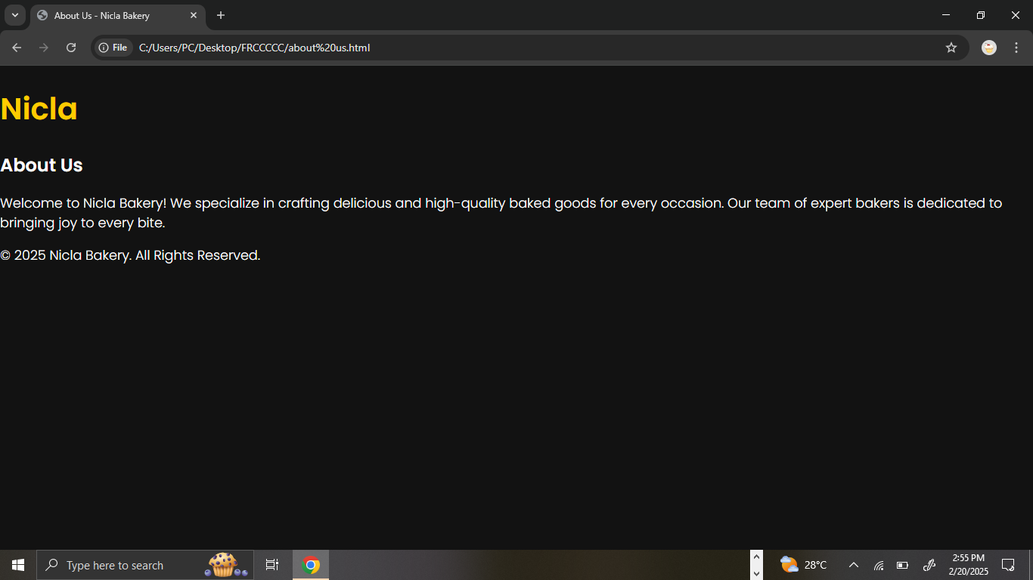
About us page

Slide 10
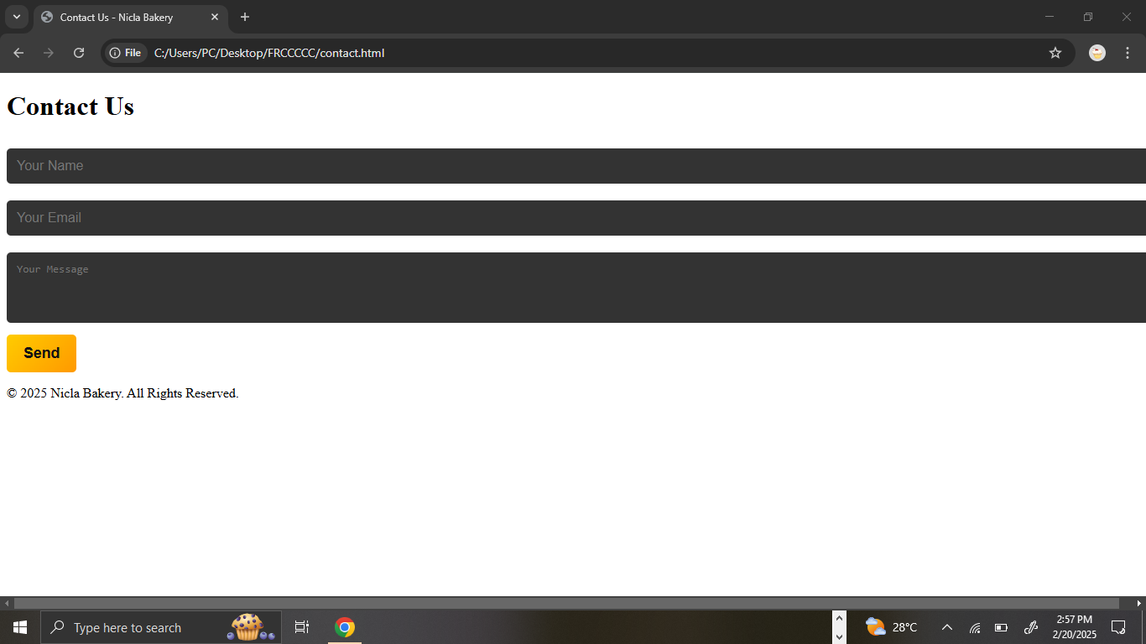
Contact us page

Slide 11
Conclusion
Thank you! Excited to bring Nicla's bakery delights to everyone online! Questions? Feedback?

